Slide 1
Libraries and loops

Slide 2
Resources
eBook
Hard Copy book
Visualizing Code tool
Cheat Sheets
*Control click to go to the link.

Slide 3
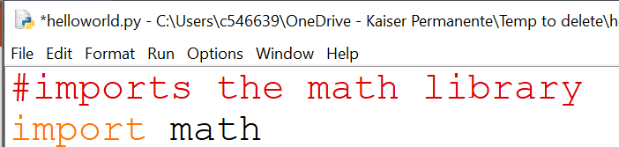
libraries
If the library is pre-installed, you will need to use an import statement
To access objects in the math library, use syntax math.exp(2,3) math.sqrt(16) These are called methods.
You can install libraries using pip install in the command prompt

Slide 4
Methods vs functions
A function is a block of code that completes a specific task.
For example print() is a function that outputs data to the console
Examples of functions we have used are print(), len(), input()
A method is similar to a function except it is associated to a specific object or class
For example random.choice() is a function that only exists in the random library
If you have a list called groceries, then groceries.insert() only exists within that object

Slide 5
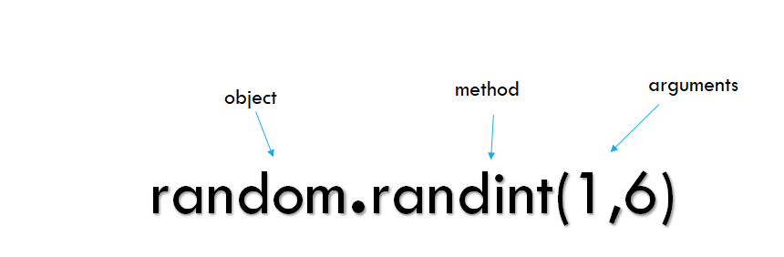
Methods vs functions

Slide 6
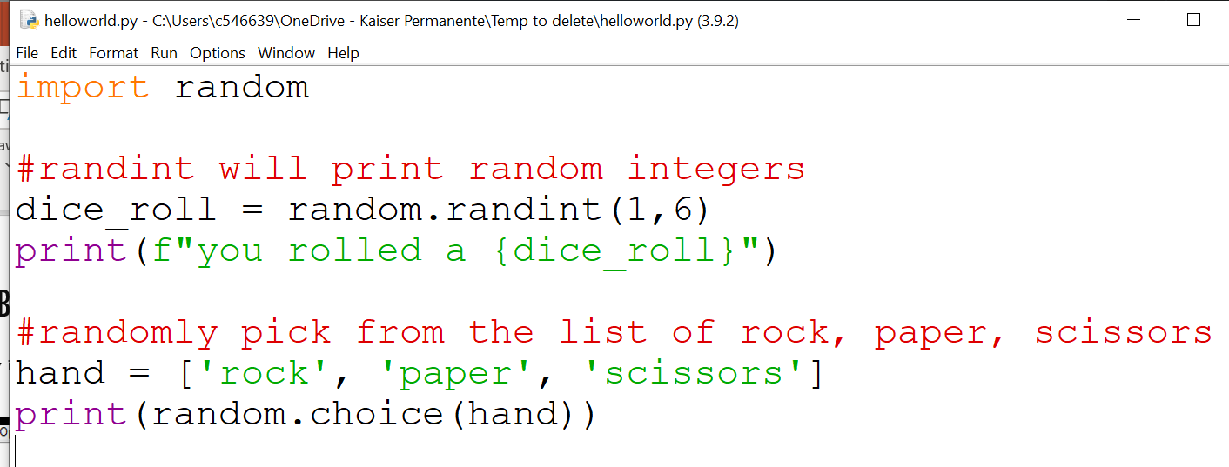
Random library
The random library is pre-built and allows you to generate randomness into your program
Notes:
https://docs.python.org/3/library/random.html
import random
#randint will print random integers
dice_roll = random.randint(1,6)
print(f"you rolled a {dice_roll}")
#randomly pick from the list of rock, paper, scissors
hand = ['rock', 'paper', 'scissors']
print(random.choice(hand))

Slide 7
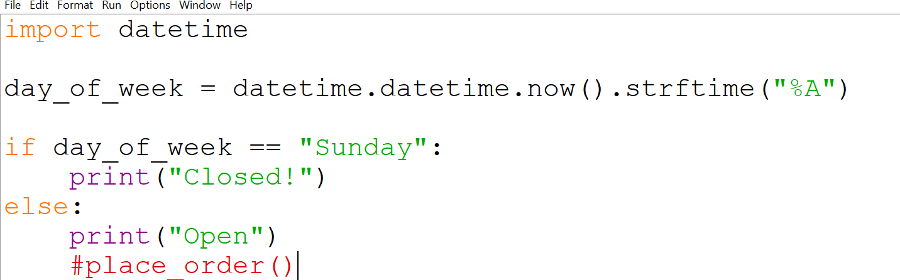
DateTime library
The datetime library is pre-built and allows you to work with dates and times
Notes:
import datetime
day_of_week = datetime.datetime.now().strftime("%A")
if day_of_week == "Sunday":
print("Closed!")
else:
print("Open")
#place_order()

Slide 8
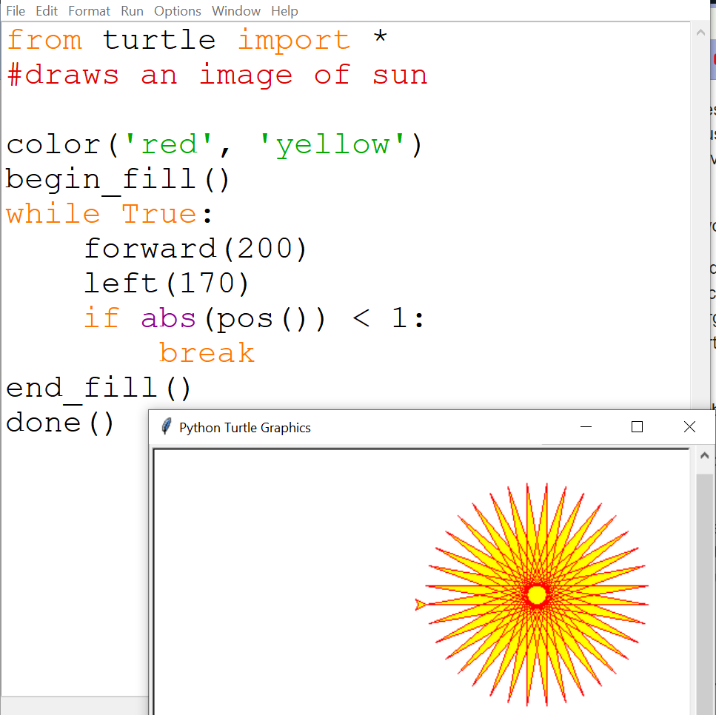
Turtle library
The turtle library is pre-built and allows you to draw images
Notes:
from turtle import *
color('yellow', 'orange')
begin_fill()
while True:
forward(200)
left(170)
if abs(pos())<1:
break
end_fill()
done()

Slide 9
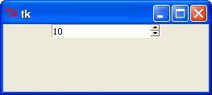
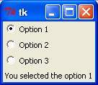
Tkinter library
The sys library is pre-built and allows you to create graphic user interfaces (GUI)

Slide 10
For Loops vs While loops
Loops allow you to repeat your code and automate tasks
For loops are commonly used to iterate over lists or ranges and you know the code needs to run a certain number of times
A while loop is conditionally based and commonly used when you don’t know how many times the code needs to repeat
In some cases, both options will produce the same result

Slide 11
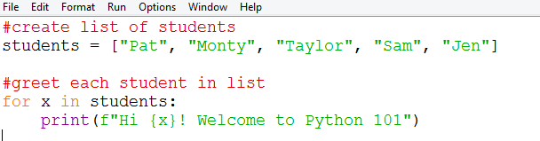
For Loops
The code in the body of the loop is executed repeatedly.
This is called an iteration
Notes:
#create list of students
students = ["Pat", "Monty", "Taylor", "Sam", "Jen"]
#greet each student in list
for x in students:
print(f"Hi {x}! Welcome to Python 101")

Slide 12
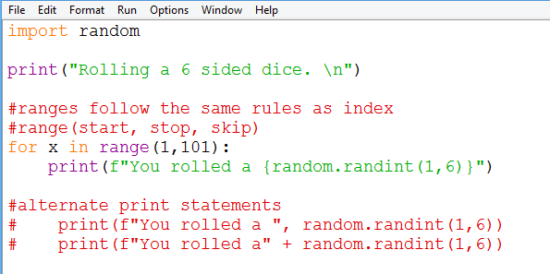
For Loops Example
This program will roll a 6 sided side dice 100 times

Slide 13
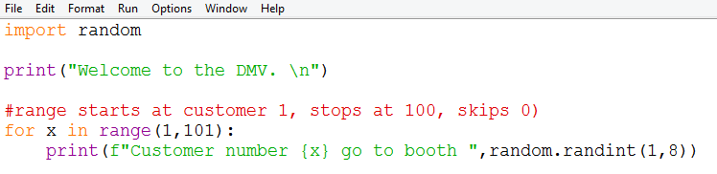
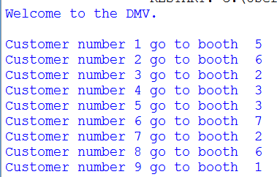
Looping example
The DMV has 100 customers and they need to assign each customer to a random booth
Requirements:
print a Welcome message.
Use a for loop to print a line for each customer (there are 100 customers)
Each customer has to be randomly assigned to one of 8 booths in the DMV
Notes:
import random
print("Welcome to the DMV. \n")
#ranges follow the same rules as index
#range(start, stop, skip)
for x in range(1,101):
print(f"Customer number {x} go to booth ",random.randint(1,8))

Slide 14
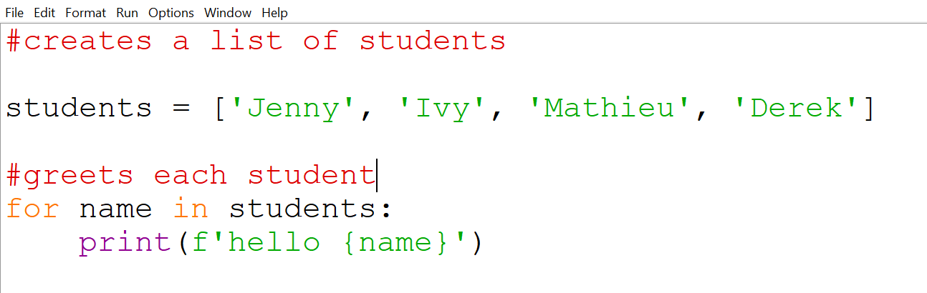
Looping over a list
Notes:
name = input("What is your name? ")
print(f"Hello {name}")
#create list of students
items = ["Hairbrush", "Night Light", "Soap", "Straws"]
#greet each student in list
for i in items:
print(f"{i} cost one dollar")

Slide 15
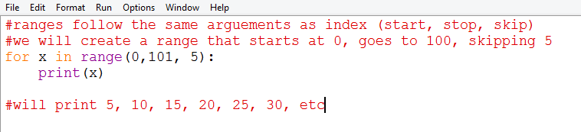
Loops to Iterate over Ranges
Rather than iterating over lists, you can iterate over a range to control exactly how many times the loop runs
Ranges follow the same rules as indexing (inclusive start, exclusive stop, skip)

Slide 16
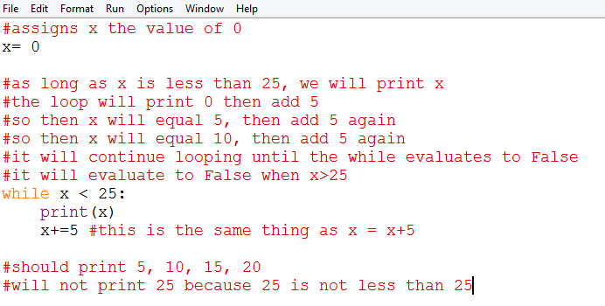
While Loops
While loops follow similar syntax to for loops and if statements (colon after the statement and indentation)
It allows you to loop through certain code as long as the conditions return True

Slide 17
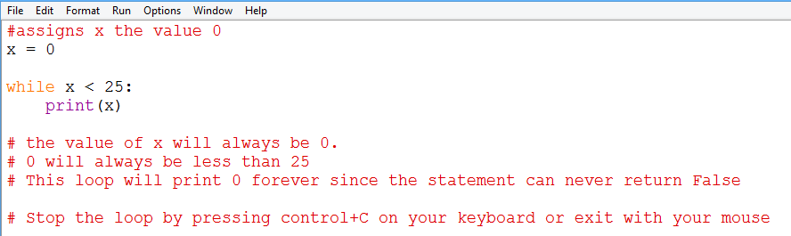
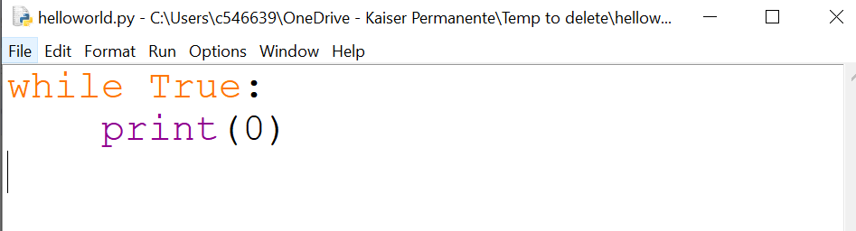
Infinite Loops
Loops and if statements execute when it evaluates to the Boolean value True
If the expression never evaluates to False, a loop will continue looping forever
Notes:
#assigns x the value 0
x = 0
while x < 25:
print(x)
# the value of x will always be 0.
# 0 will always be less than 25
# This loop will print 0 forever since the statement can never return False
# Stop the loop by pressing control+C on your keyboard or exit with your mouse

Slide 18
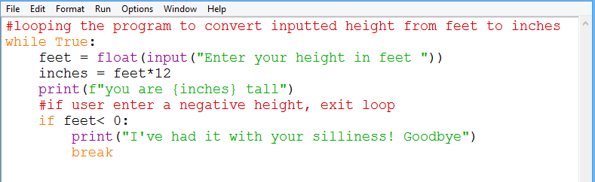
Break and Continue
You can use keywords Break and Continue to redirect loops
Break will exit the loop.
Continue will re-run the loop from the beginning
These can only be used in loops.

